Slide 1
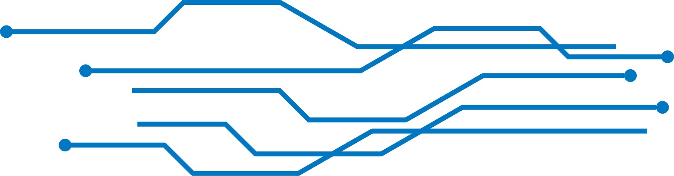





Web Application Vulnerabilities
Explaining the OWASP Top 10 Security Risks
presented by: Kutu

Slide 2

INTRODUCTION
  Importance of web applications
  Why attackers target them
  Need for cybersecurity
  Purpose of OWASP

Slide 3
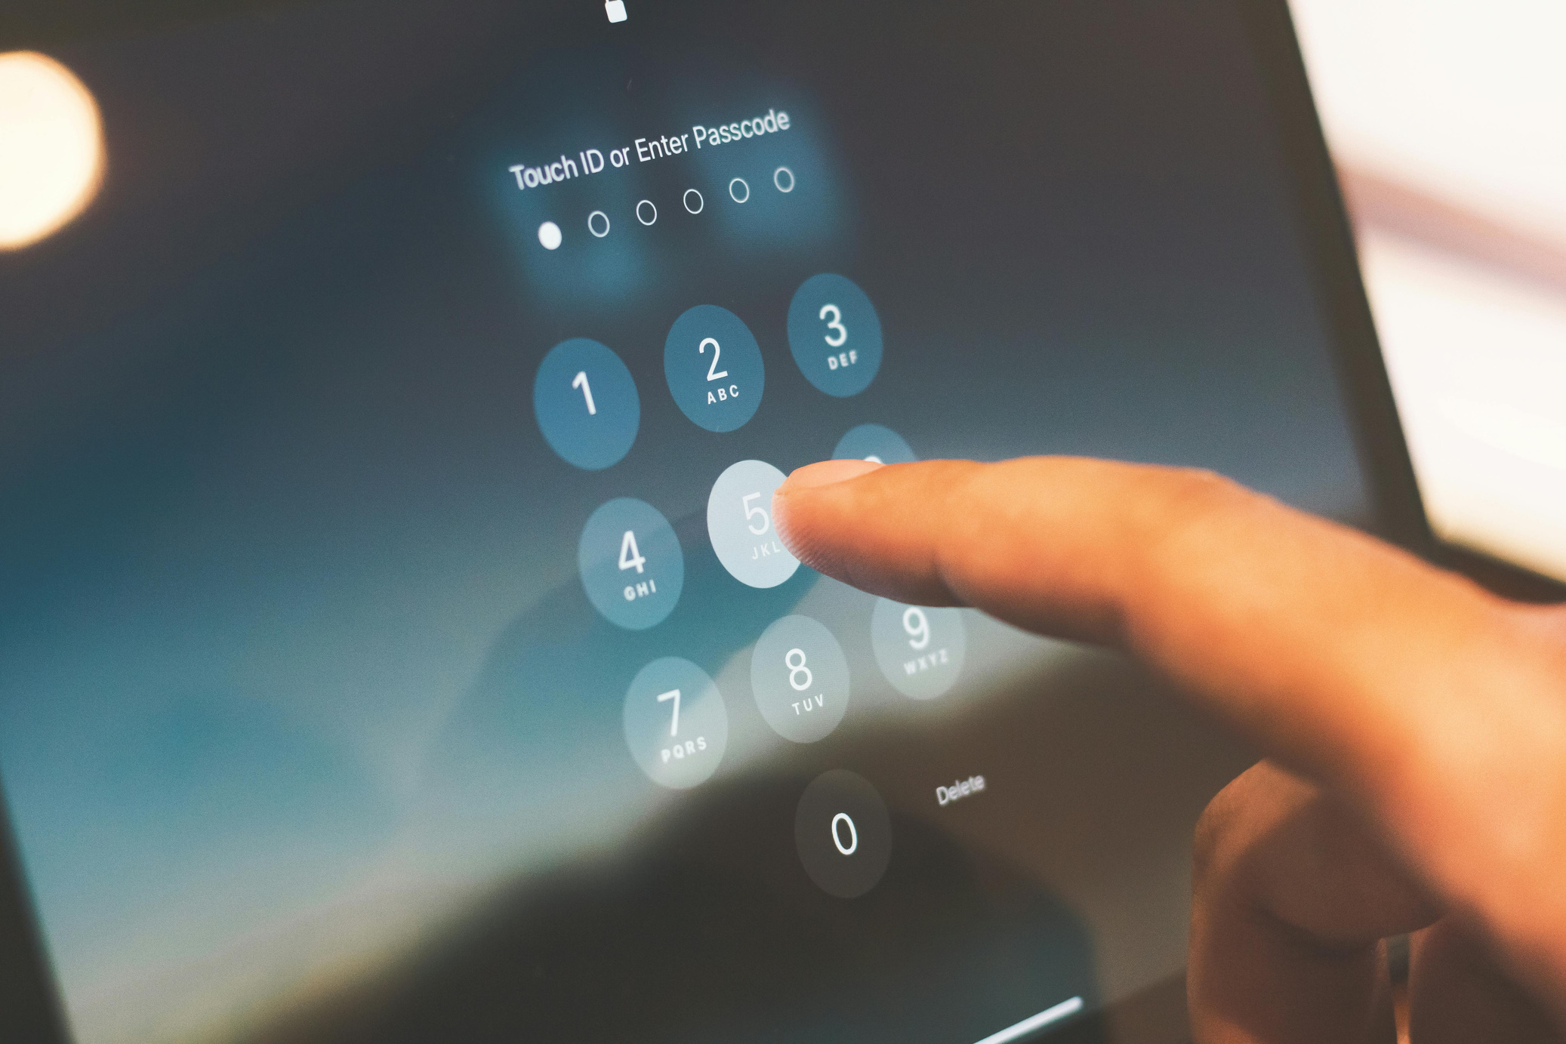
WHAT IS OWASP?
OPEN WORLDWIDE APPLICATION SECURITY PROJECT (OWASP)
NON-PROFIT ORGANIZATION
IMPROVES APPLICATION SECURITY
PUBLISHES OWASP TOP 10
USED WORLDWIDE

Slide 4
OWASP TOP 10 OVERVIEW
Broken Access Control
Vulnerable Components
Cryptographic Failures
Identification & Authentication Failures
Injection
Software & Data Integrity Failures
PHISHING ATTACKS
Insecure Design
Logging & Monitoring Failures
DDOS ATTACKS
Security Misconfiguration
SSRF( Server-Side Request Forgery)

Slide 5
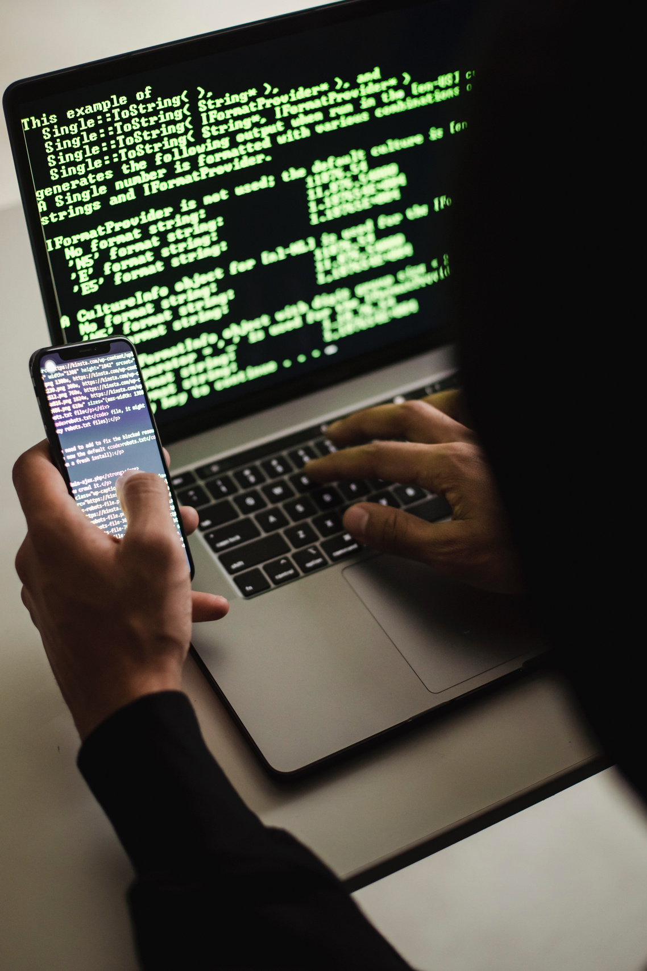
BROKEN ACCESS CONTROL
Users gain unauthorized access due to missing authorization checks . Impact: data theft .
Mitigation: least privilege, server-side checks .

Slide 6
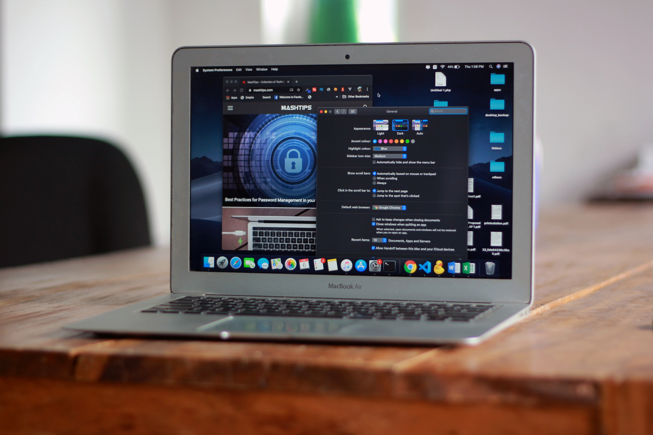
CRYPTOGRAPHIC FAILURES
Sensitive data exposed through weak encryption or poor key management.
Mitigation: HTTPS, strong encryption.

Slide 7
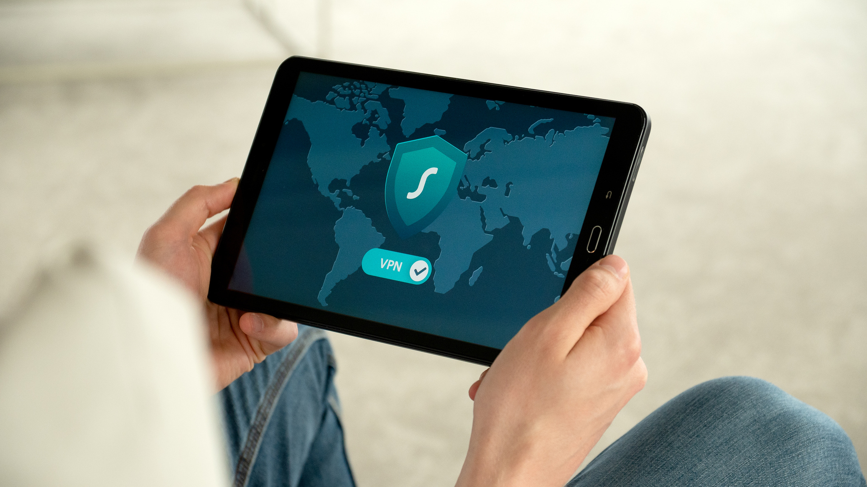
INJECTION
Malicious input executed as SQL/commands.
Mitigation: parameterized queries, input validation.

Slide 8
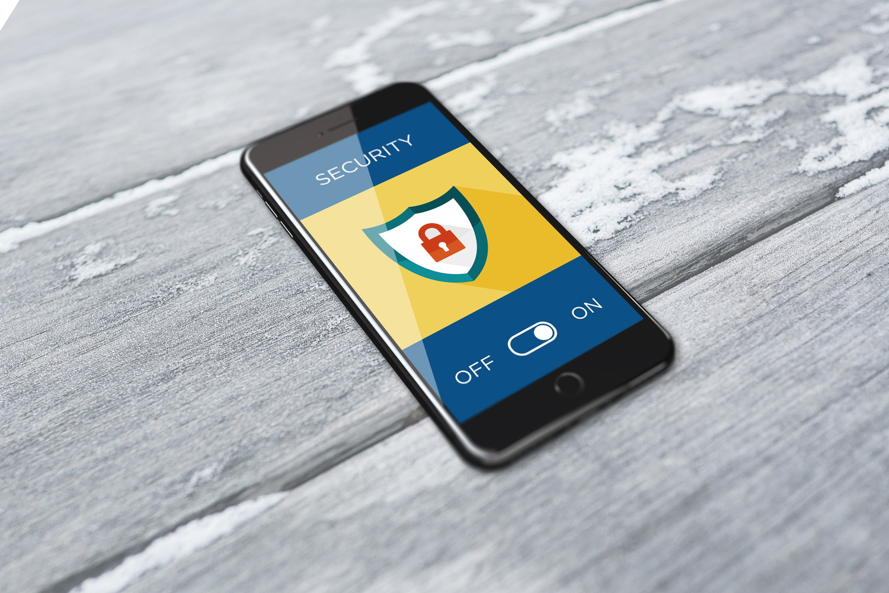
INSECURE DESIGN
Security missing at design stage.
Mitigation: threat modeling, secure SDLC ( Software Development Life Cycle).

Slide 9

SECURITY MISCONFIGURATION
Unsafe default settings, exposed services.
Mitigation: secure configuration, hardening.

Slide 10


VULNERABLE & OUTDATED COMPONENTS
Old libraries with known flaws.
Mitigation: patch and update regularly.

Slide 11


IDENTIFICATION & AUTHENTICATION FAILURES
Weak passwords, missing MFA, poor sessions.
Mitigation: MFA, strong passwords, lockout.

Slide 12
SOFTWARE & DATA INTEGRITY FAILURES
Unverified updates or software supply-chain issues.
Mitigation: code signing, integrity checks.

Slide 13

LOGGING & MONITORING FAILURES
Poor logging delays attack detection.
Mitigation: centralized monitoring and alerting.

Slide 14
SERVER-SIDE REQUEST FORGERY (SSRF)
Server abused to request internal resources.
Mitigation: validate URLs, network restrictions.

Slide 15
CASE STUDY: EQUIFAX (2017)
Apache Struts vulnerability exploited.
147M people affected.
Lesson: timely patching.

Slide 16
CASE STUDY: CAPITAL ONE (2019)
Cloud misconfiguration and SSRF exposed ~106M records.
Lesson: secure cloud configuration.

Slide 17
INDIVIDUALS
ORGANIZATIONS
Identity theft
Privacy loss
Financial fraud
Reputation damage
Financial loss
Legal penalties

Slide 18
DETECTION, MITIGATION & TOOLS
Tools: Burp Suite, OWASP ZAP, Nessus, Nmap, Wireshark.
Detection: scans, code review.
Recommendations: MFA, updates, monitoring.

Slide 19
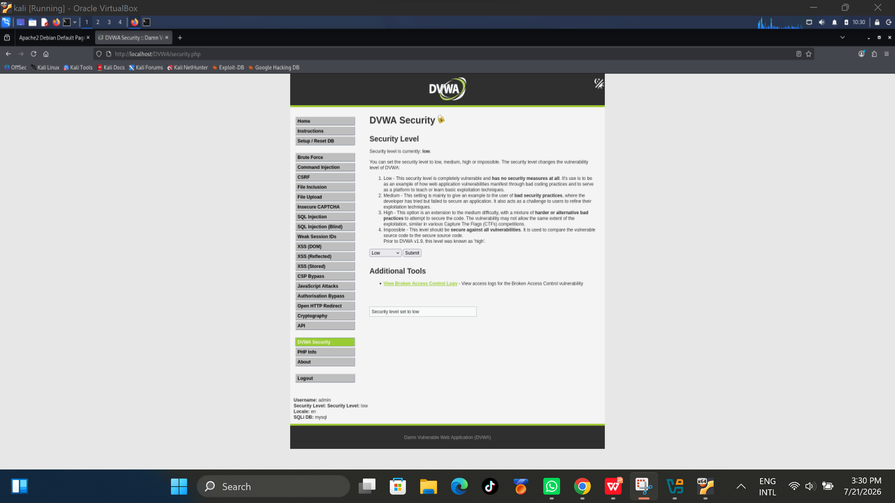
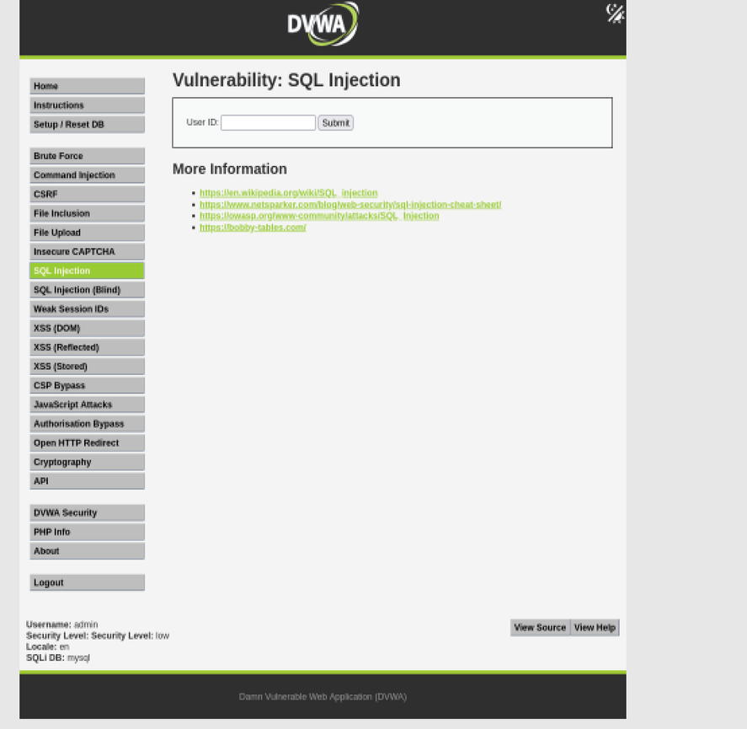
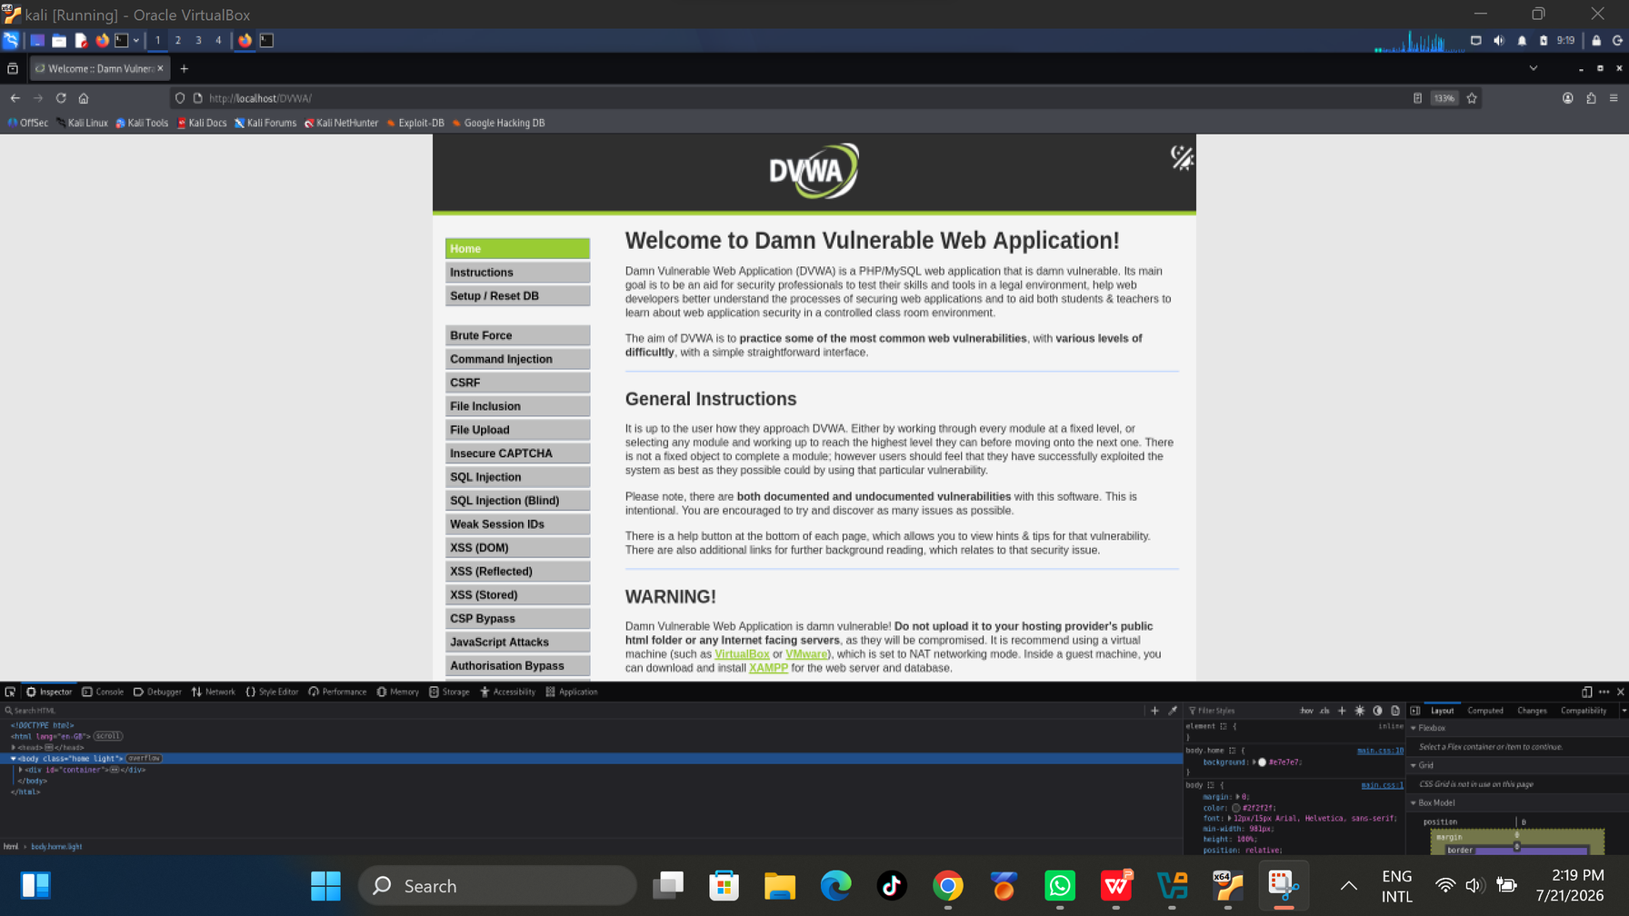
Practical lab Environment
Kali
Linux
?Apache 2.4.66
?PHP 8.4.16?
MariaDB 11.8.6?
DVWA

Slide 20
Findings:
  Successful lab setup
  Safe learning environment
  OWASP concepts understood
Conclusion
OWASP Top 10 helps prioritize web security.
It also Secure coding, testing and monitoring which reduce risk to Hackers
Recommendations:
  Validate inputs
  Parameterized queries
  Patch systems
  Regular security testing

Slide 21
References
OWASP (2021); NIST SP 800-53; OWASP Cheat Sheets; MITRE ATT&CK.

Slide 22

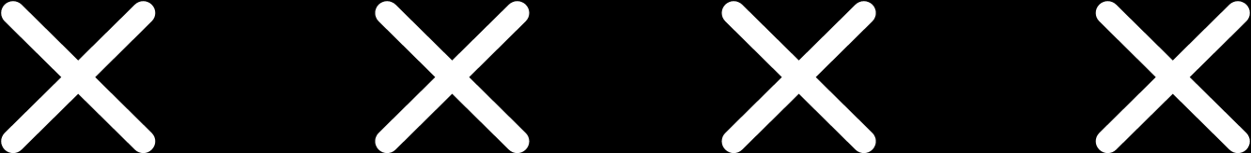

THANK YOU

